Slide 1

REPORT FOR VOICE ASSISTANT As a project work for Course PYTHON PROGRAMMING (INT213) --------------------------------------------------
Name : Vivek Sharma Registration Number : 12013688 Name : Harsh Gautam Registration Number : 12004120 Program : CSE B.tech Semester : Third School : School of Computer Engineering Name of University : Lovely Professional University
Date of submission : 20th November 2021

Slide 2
Voice Assistant 20th November 2021
Abstract
In this modern era, day to day life became smarter and interlinked with technology. We already know some voice assistance like google, Siri. etc. This project works on voice input and give output on the screen. The main agenda of our voice assistance makes people smart and give instant and computed results. The voice assistance takes the voice input through our microphone (Bluetooth and wired microphone) and it converts our voice into computer understandable language gives the required solutions and answers which are asked by the user. This assistance connects with the world wide web to provide results that the user has questioned. Natural Language Processing algorithm helps computer machines to engage in communication using natural human language in many forms.
Introduction
Virtual assistants are software programs that help you ease your day to day tasks, such as showing weather reports, creating remainders, making shopping lists etc. They can take commands via text (online chatbots) or by voice. Voice-based intelligent assistants need an invoking word or wake word to activate the listener, followed by the command. We have so many virtual assistants, such as Apple’s Siri, Amazon’s Alexa and Microsoft’s Cortana.

Slide 3
Acknowledgement
I would like to thank my mentor - Prof. Sagar Pande for his advice and inputs on this project. Many thanks to my friends and seniors as well, who spent countless hours to listen and provide feedbacks.
Context
This project has been done as part of my course for the B.TECH CSE at Lovely Professional University. Supervised by Sagar Pande Sir, I have two months to fulfil the requirements in order to succeed the module.

Slide 4
Team Members
Team Leader:
Vivek
Contribution:
Coding
Idea
Research
Harsh
Contribution:
Idea
Testing
Coding

Slide 5
LIBRARIES USED Pyttsx3 : pyttsx3 is a text-to-speech conversion library in Python. Unlike alternative libraries, it works offline and is compatible with both Python 2 and 3. An application invokes the pyttsx3.init() factory function to get a reference to a pyttsx3. Engine instance. it is a very easy to use tool which converts the entered text into speech. Speech Recognition : Speech Recognition is an important feature in several applications used such as home automation, artificial intelligence, etc. This article aims to provide an introduction on how to make use of the SpeechRecognition library of Python. This is useful as it can be used on microcontrollers such as Raspberri Pis with the help of an external microphone.
PRE-REQUISITES
• Python Interpreter
• Pycharm or VS Code
• Internet connection

Slide 6
Datetime: In Python, date and time are not a data type of their own, but a module named datetime can be imported to work with the date as well as time. Python Datetime module comes built into Python, so there is no need to install it externally.
Wikipedia:
Wikipedia is a multilingual online encyclopedia created and maintained as an open collaboration project by a community of volunteer editors using a wiki-based editing system. In this article, we will see how to use Python’s Wikipedia module to fetch a variety of information from the Wikipedia website

Slide 7
OS:
An operating system acts as an intermediary between the user of a computer and computer hardware. The purpose of an operating system is to provide an environment in which a user can execute programs conveniently and efficiently.
Web Browser
When we need any kind of information most of the time we get help from the Internet, and we get information. The Internet provides us useful information easily; we use mobile phones, computers, and tablets. We searched for a lot of things in our daily life, so we get information about all over the world, but we can not get information by just only getting connected to the Internet. We need a platform where we can search for our questions. The platform that provides such kinds of services is called a web browser, without a web browser internet will not be able to provide information.

Slide 8
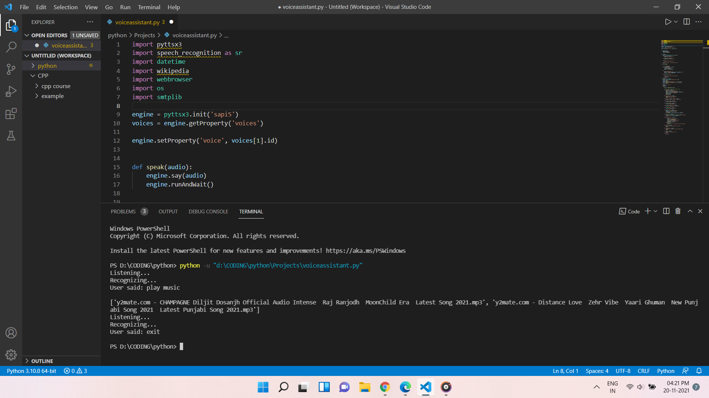
Screen Shot
Recognizing

Slide 9
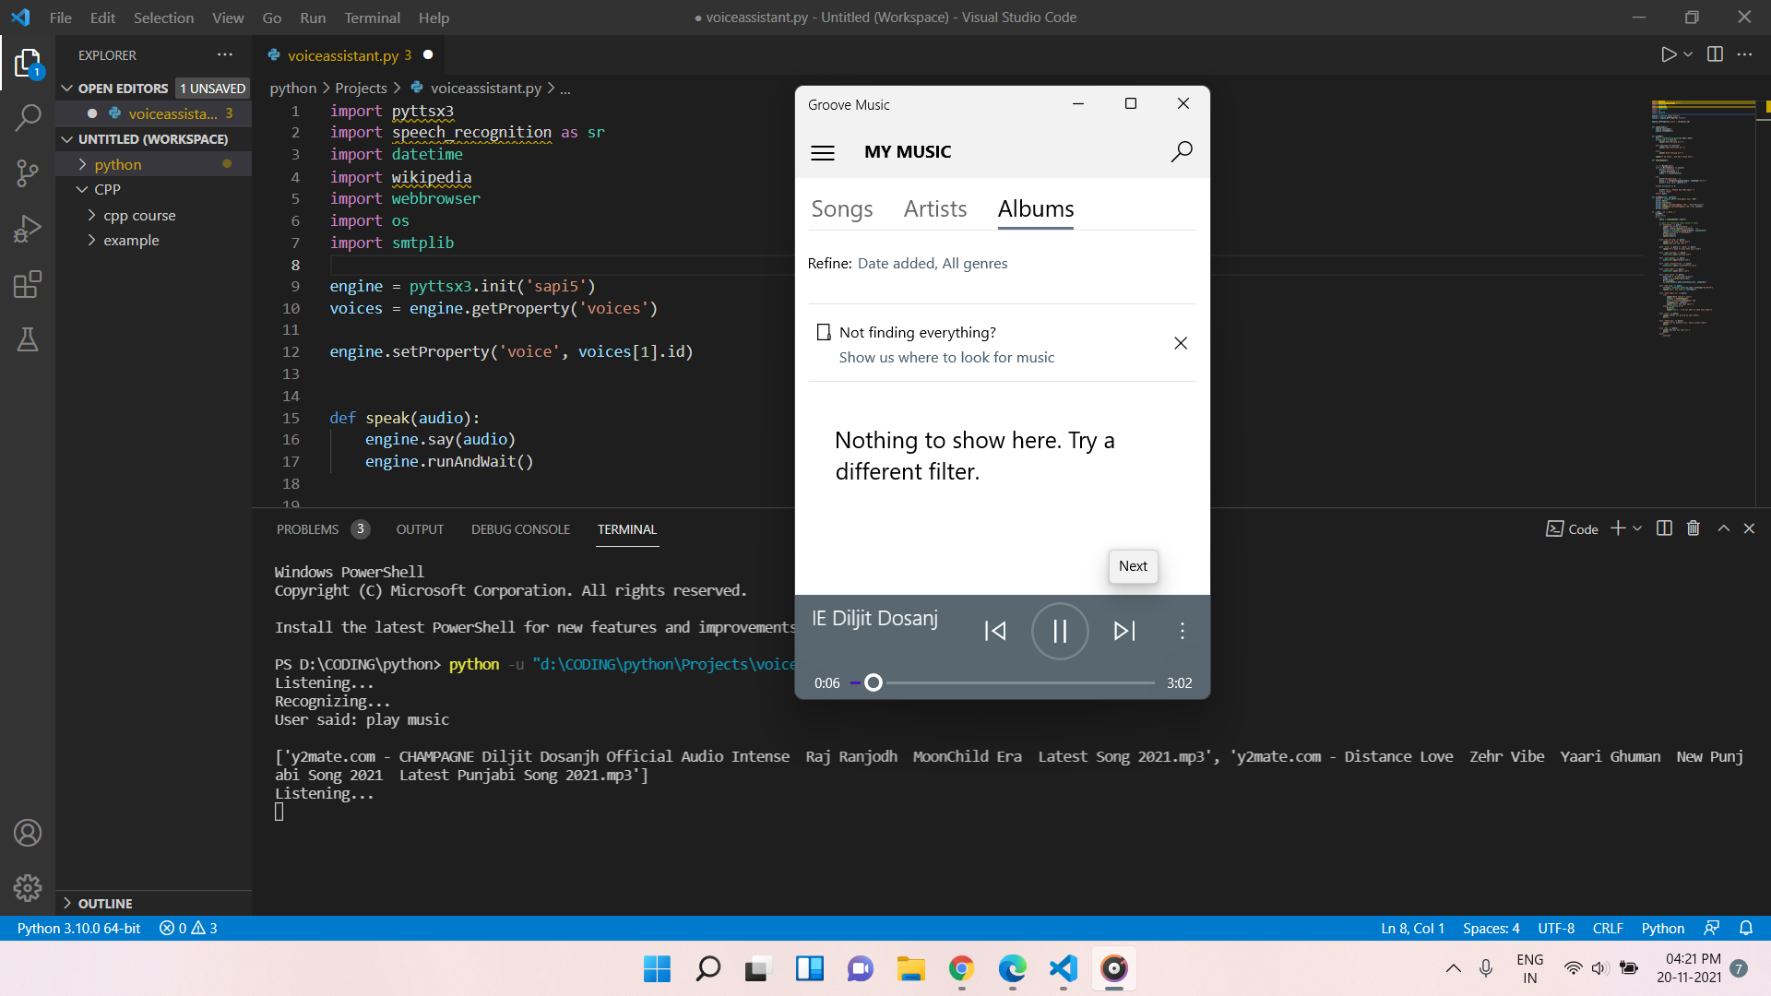
Performing Functions:

Slide 10
Advantages:
Save Time
Hand-Free Operations
Give Voice Commands and get output
Some Basic Knowledge:
What are Modules
A Python module is a file containing Python definitions and statements. A module can define functions, classes, and variables. A module can also include runnable code. Grouping related code into a module makes the code easier to understand and use. It also makes the code logically organized

Slide 11
What is AI ?
Artificial intelligence is the simulation of human intelligence processes by machines, especially computer systems. Specific applications of AI include expert systems, natural language processing, speech recognition and machine vision
About Python :
Python is an interpreted, object-oriented, high-level programming language with dynamic semantics. ... Python's simple, easy to learn syntax emphasizes readability and therefore reduces the cost of program maintenance. Python supports modules and packages, which encourages program modularity and code reuse
Conclusion:
The world is moving towards technology to create things that can make our work easy and save time thinking of that our team created a voice assistant that save your time by doing some part of your work on just your voice command .

Slide 12
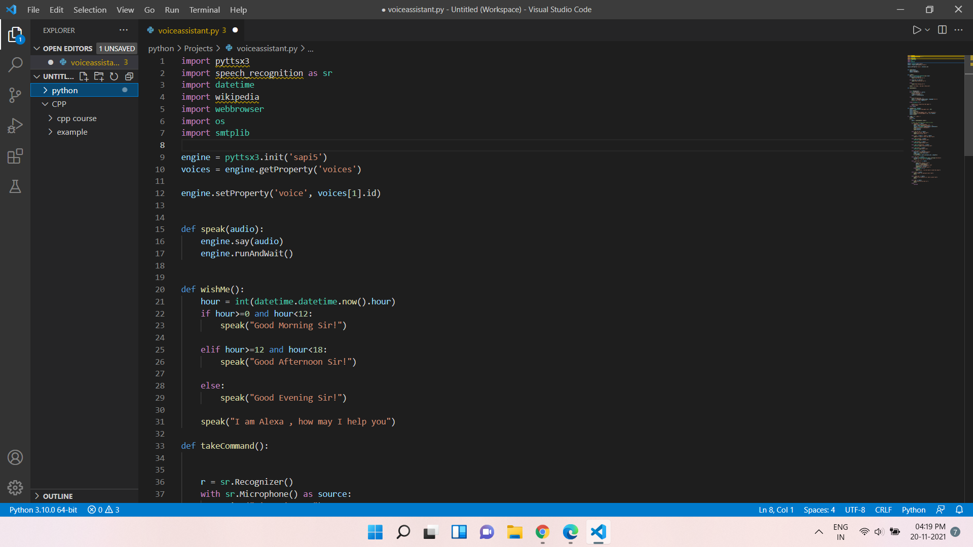
Code

Slide 13
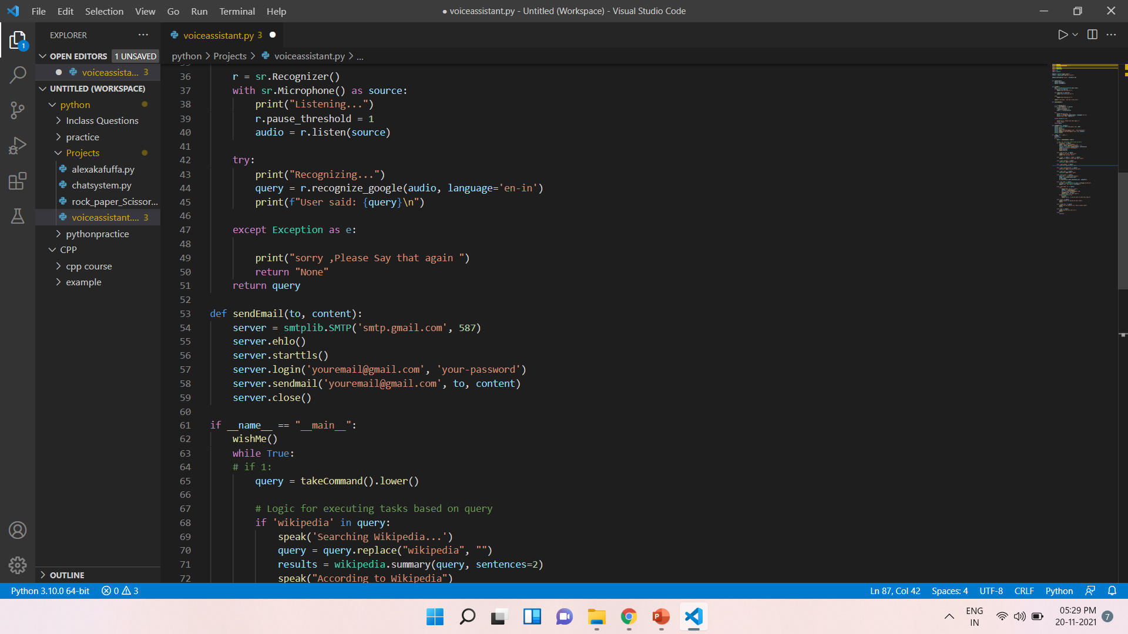

Slide 14
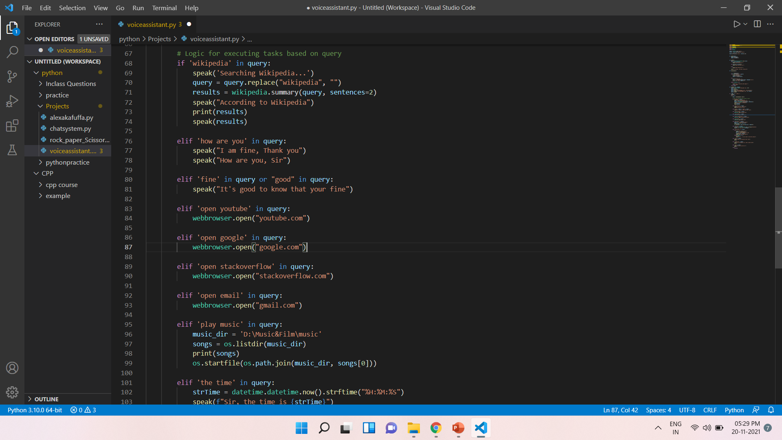

Slide 15
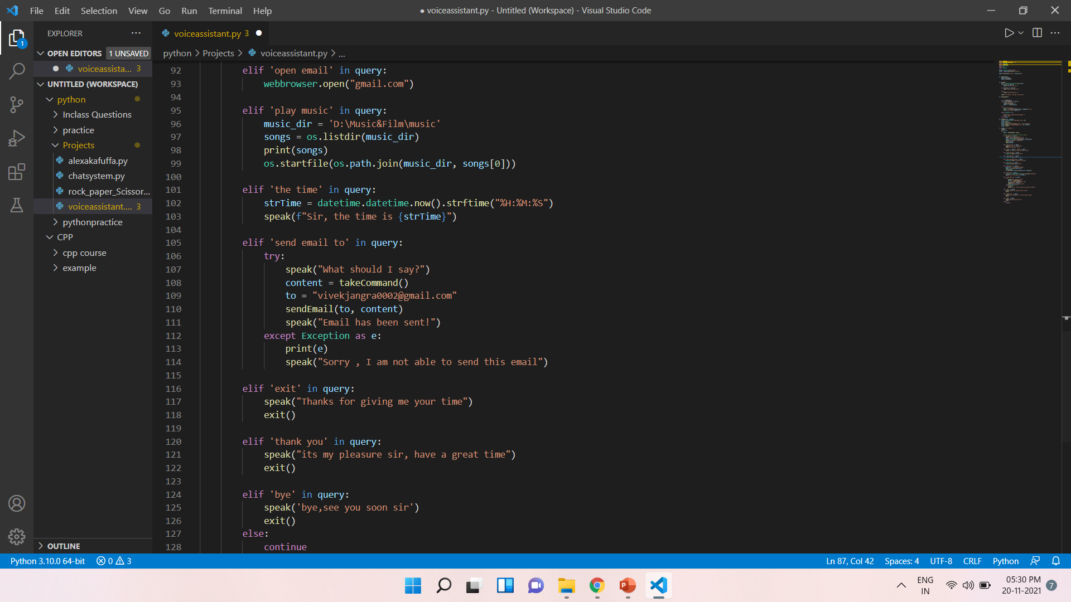

Slide 16
References:
Youtube
Unschool
HackerRank
Coursera

